Slide 1


Long term plan rational:
The White Rose Maths long-term plans provide a coherent and carefully sequenced pathway that supports every child to make strong progress in mathematics. Learning is built step by step, allowing pupils to develop understanding, confidence and resilience as they move through the curriculum and prepare for new learning. New concepts are introduced in manageable stages, ensuring that children can build securely on what they already know, becoming increasingly independent in their thinking and problem-solving.
Alongside the White Rose curriculum, Mastering Number in KS1 and Number Sense in KS2 is embedded within our provision, to strengthen pupils' understanding of number and secure essential foundations. By prioritising strong number sense from the earliest stages, pupils are better equipped to access new learning and tackle increasingly complex mathematical concepts with confidence.
Regular opportunities for retrieval, practice and consolidation are woven throughout the curriculum, enabling pupils to revisit key ideas, strengthen understanding and make meaningful connections across different areas of mathematics. This cyclical approach helps knowledge and skills become embedded over time, reducing cognitive load and supporting long-term retention.
By combining the structured progression of White Rose Maths with the targeted support of Mastering Number and Number Sense, we create a learning environment where every child can build secure foundations, develop positive mathematical identities and achieve sustained success over time.

Slide 2
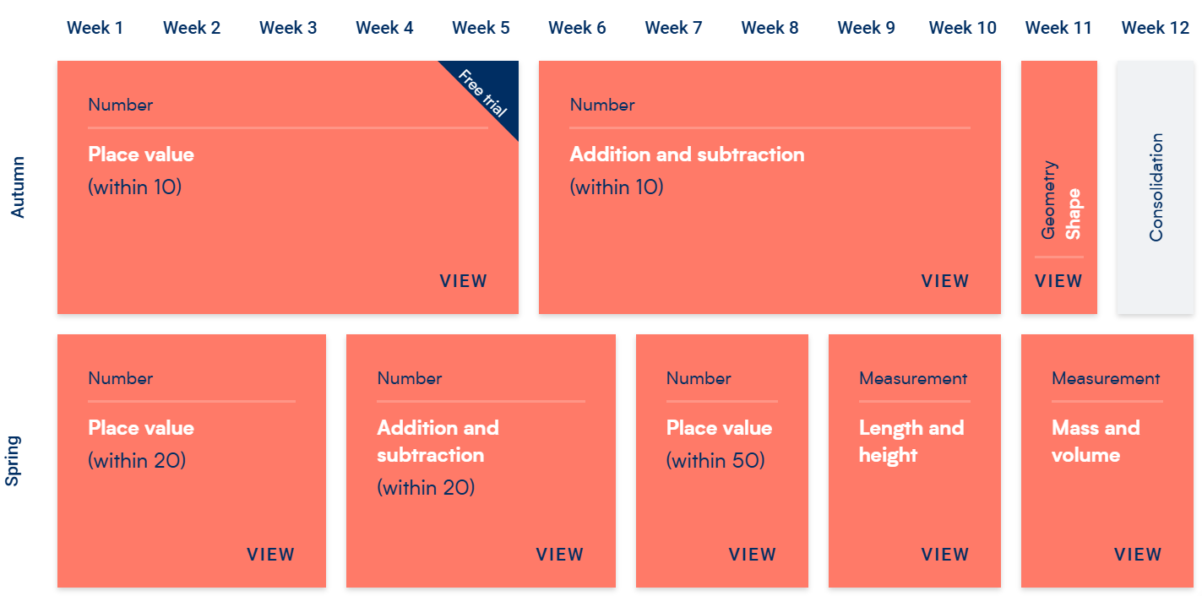
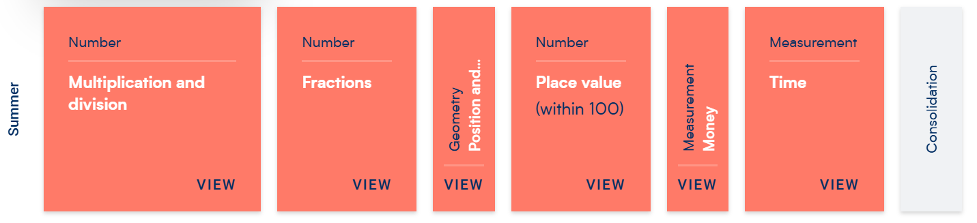
Subject Overview : Maths Year 1

Slide 3
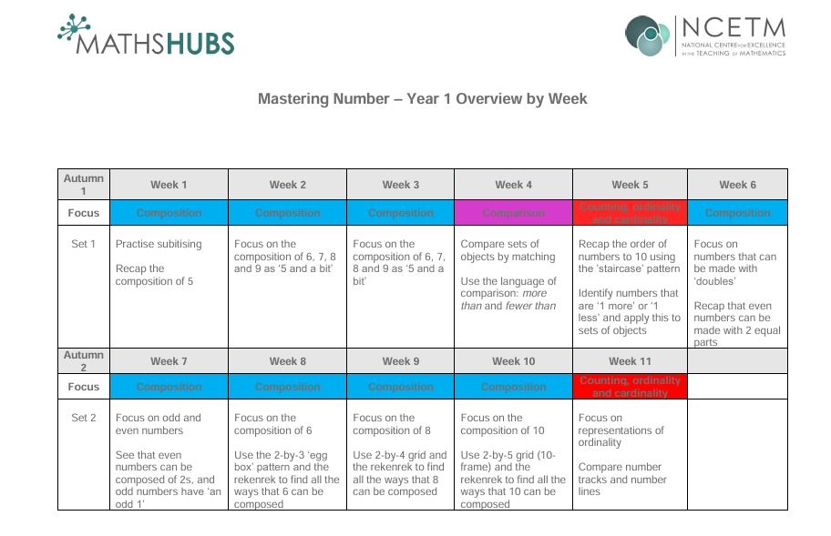

Slide 4
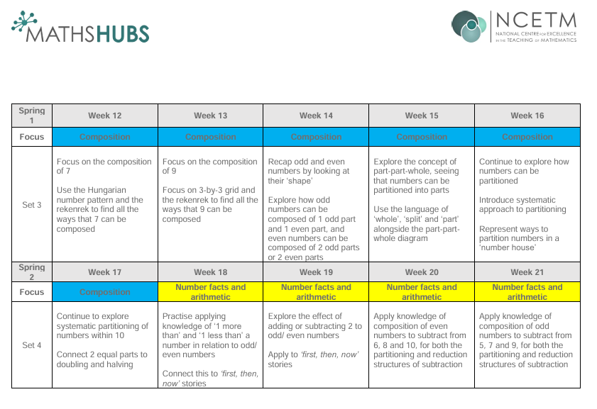

Slide 5
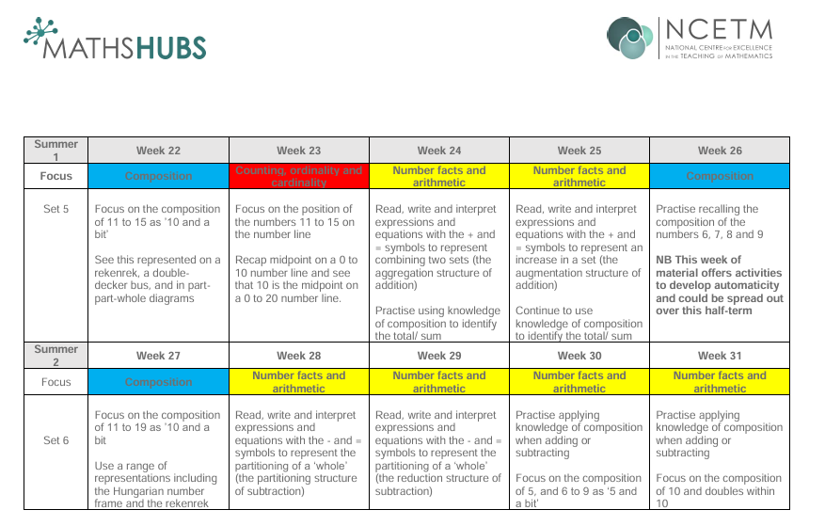

Slide 6
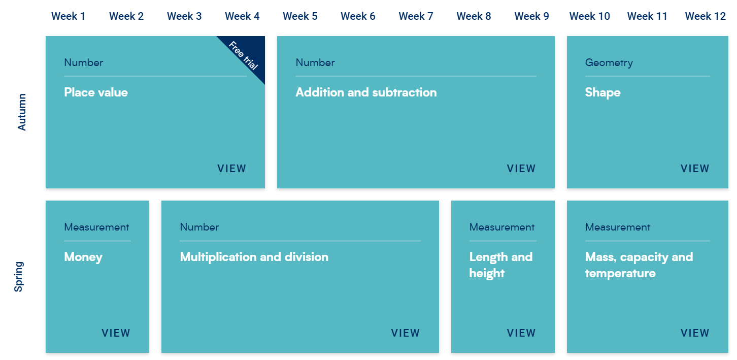
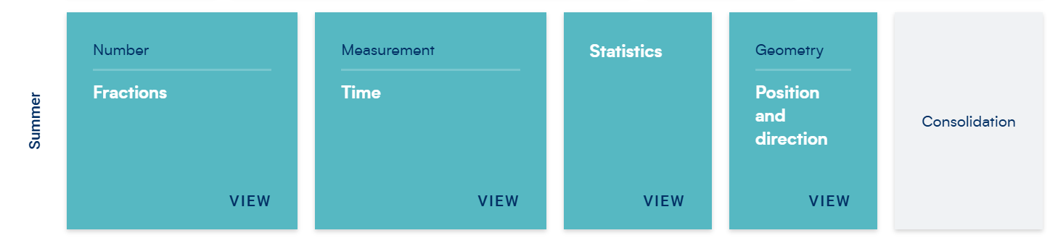
Subject Overview : Maths Year 2

Slide 7
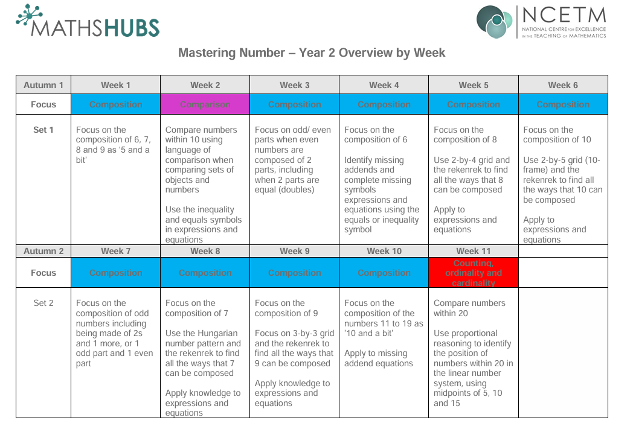

Slide 8
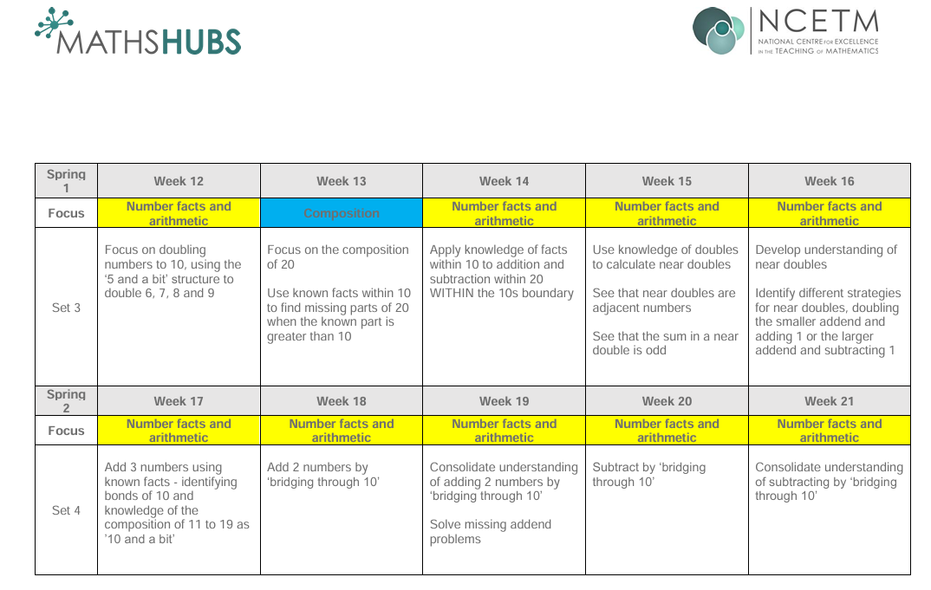

Slide 9
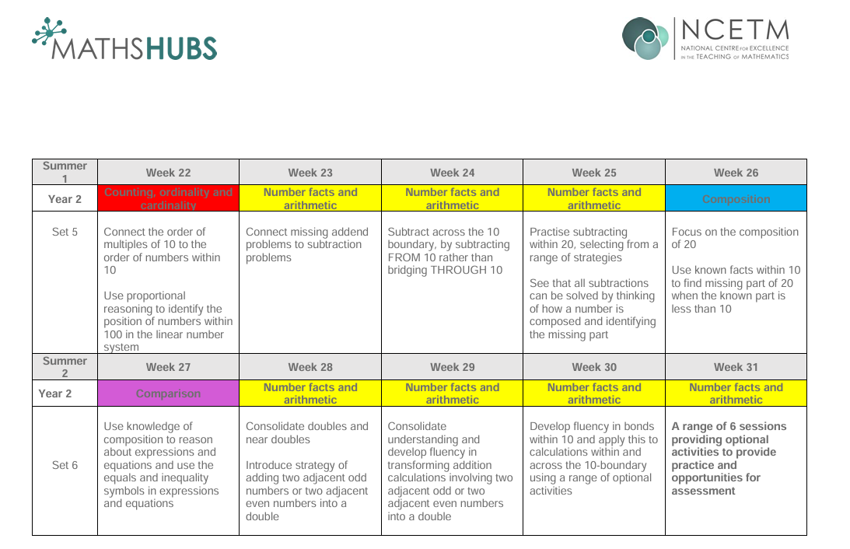

Slide 10
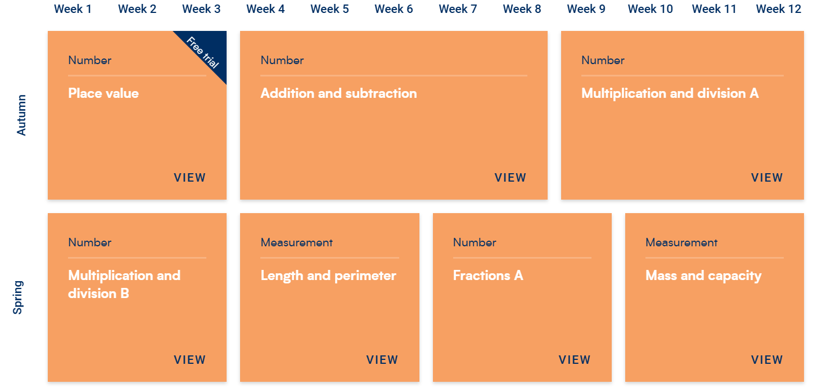
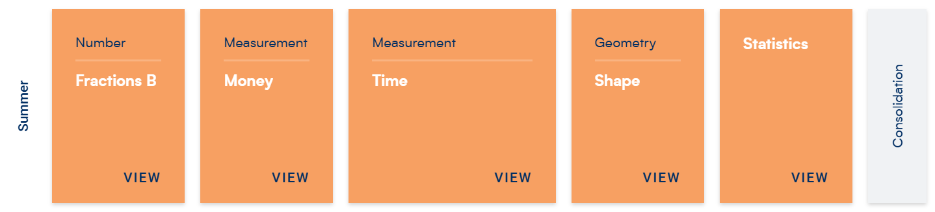
Subject Overview : Maths Year 3

Slide 11
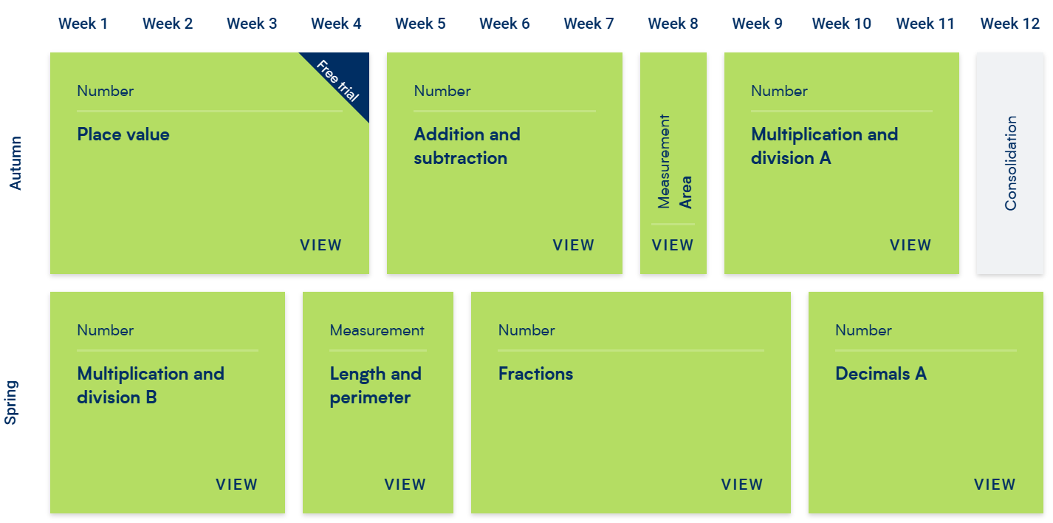
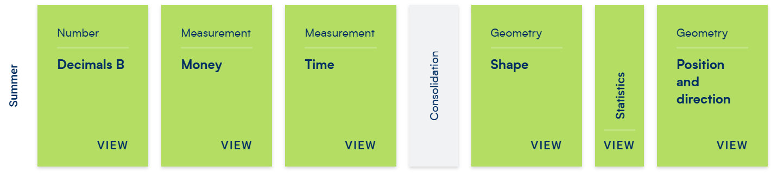
Subject Overview : Maths Year 4

Slide 12
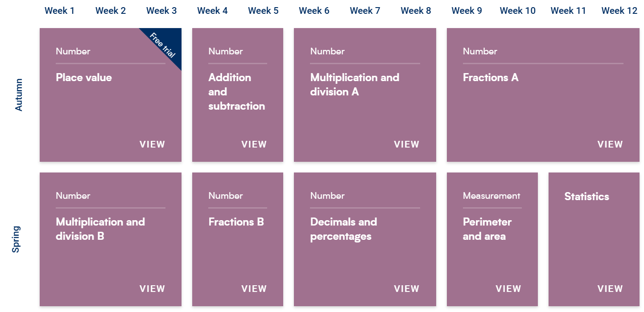
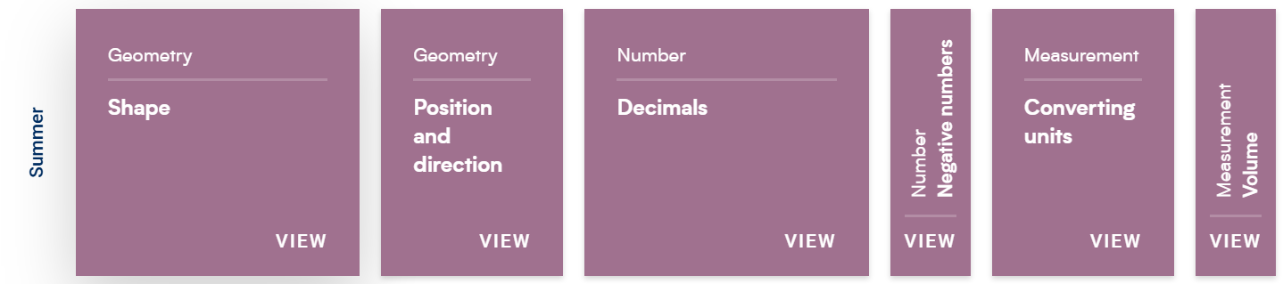
Subject Overview : Maths Year 5

Slide 13
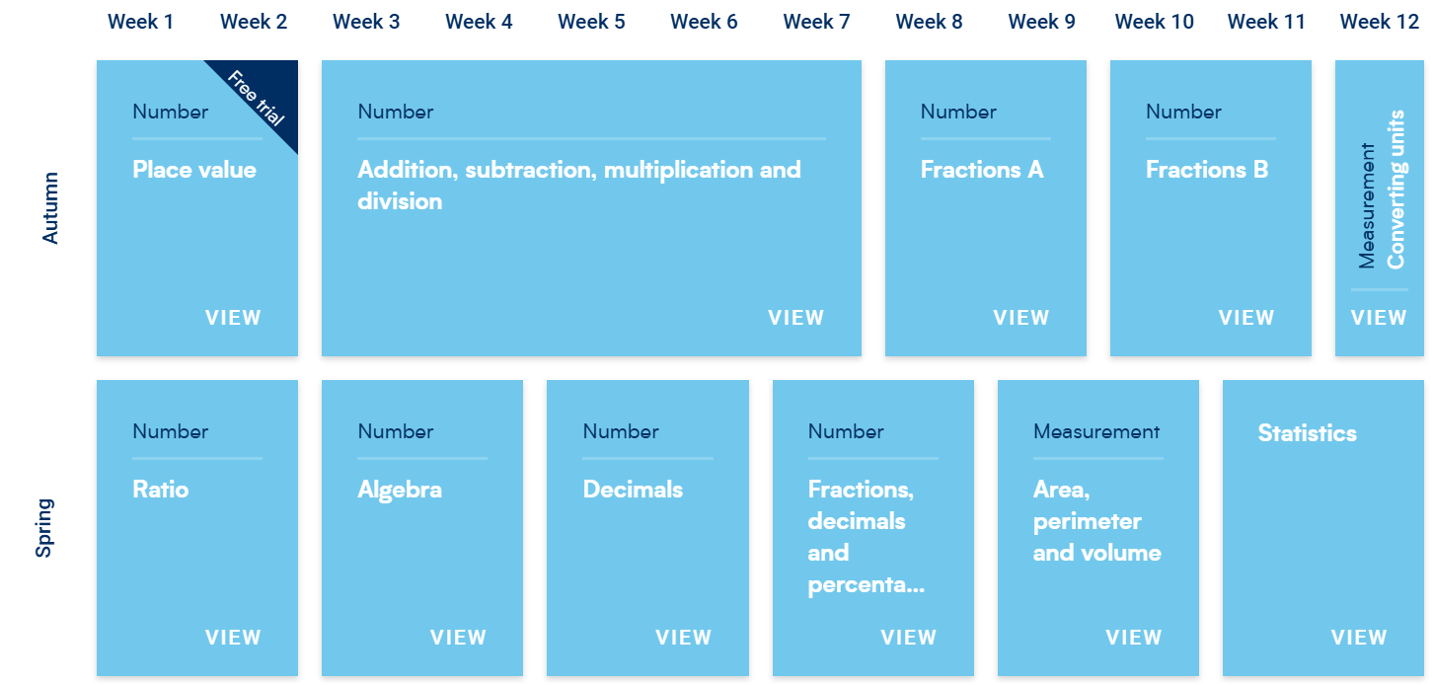

Subject Overview : Maths Year 6

